Slide 1

Engagement
&
Active Listening
Coaching
Session 2 For Leaders

Slide 2




Slide 3

Project Purpose
What's
To provide support to Family Success Center Leadership in their coaching of FSC talent
To provide a strong conceptual basis, tools, and opportunities to practice new approaches in Coaching for Leaders
To assist with ongoing integration of the Practice Profile into existing FSC systems
To provide tools, resources, and a consistent, self-directed system for teaching FSC talent about the Essential Functions

Slide 4

Project Objectives
Increase participants’ understanding of the role and benefit of the “coaching skill” for a leader and enhance their ability to develop others & shape desired behavior
Through heightened self-awareness, provide opportunities for participants to learn how to execute coaching methodology that brings about behavioral change in themselves, others, and the system for full Practice Profile integration

Slide 5

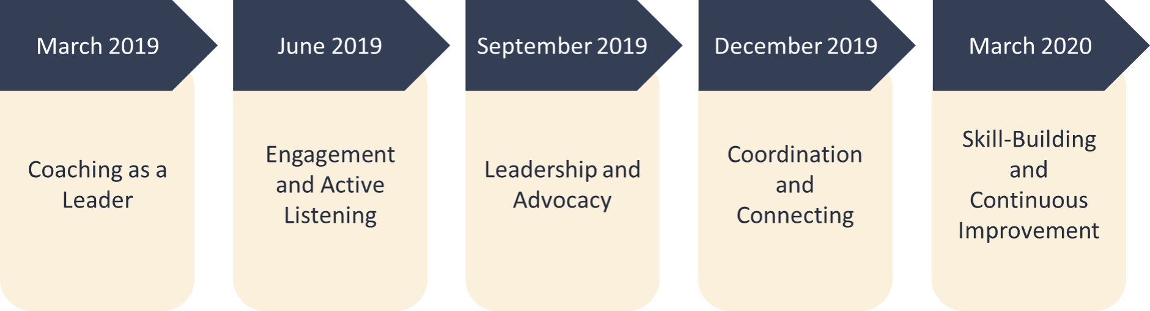
Project Timeline______________________

Slide 6


9:00 Welcoming – Introduction to the Day
9:20 Foundational Recap
10:20 Engagement & Active Listening: How it Shows Up In Practice
10:35 Break (Enjoy ☺)
10:45 Exploring Engagement for Leaders
12: 00 Debrief Morning Activities/Frame Out Afternoon
12:15 Lunch (Enjoy and Rejuvenate ☺)
12:45 Exploring Active Listening for Leaders
1:45 Break (Enjoy ☺)
1:55 Coaching Round Robin
2:40 Application/Self-Directed Work
3:20 Wrap Up
3:30: Adjourn
Thank You

Slide 7

Desired Outcomes for Todays Session “2”
Review for deeper understanding , key coaching definitions and their link to the Family Success Center culture& Practice Profile
Experience, through practice, key coaching skills
    Seek the Issue
    Clarify Thinking
    Contribute
    Push for Action
Understand Engagement & Active Listening
Connect the coaching skills to Engagement & Active Listening
Make a Plan for application: Use coaching skills/self-directed learning to teach FSC staff Engagement & Active Listening
Directors/Leaders will have an opportunity to learn and apply the fundamental aspects of Engagement & Active Listening as defined by the Practice Profile

Slide 8
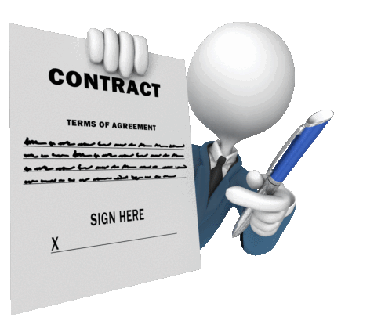
Working Agreement
Sean will review our Agreement from last session
These are our commitments to each other to have a successful day
Please add anything additional to make this a great environment
Utilize the Thought Sheets in front of your table
Working Agreement
For
June 28, 2019
Lisa & Sean

Slide 9


Let’s see What the Survey Says?

Slide 10

Pre- Knowledge Evaluation

Slide 11


Deep Listening
Remaining Present
Deep Listening
Remaining Present
Centering Yourself for Coaching

Slide 12


Teaching: Reinforcement Activities
Getting Ready for Practice!
Rapid Fire Game
Group Reflection

Slide 13
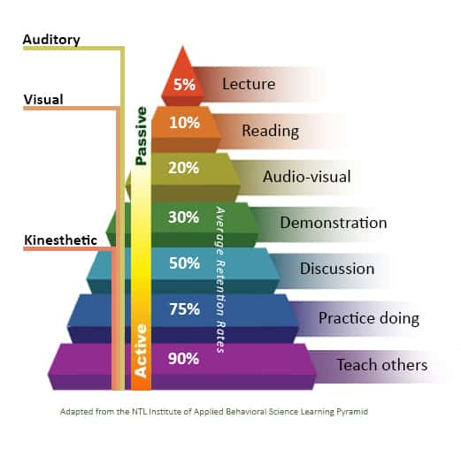

How Do you reach Behavioral Change?
How do you reach Retention and Recall?
Increase Retention, Recall and Application
Visual
&
Kinesthetic

Slide 14
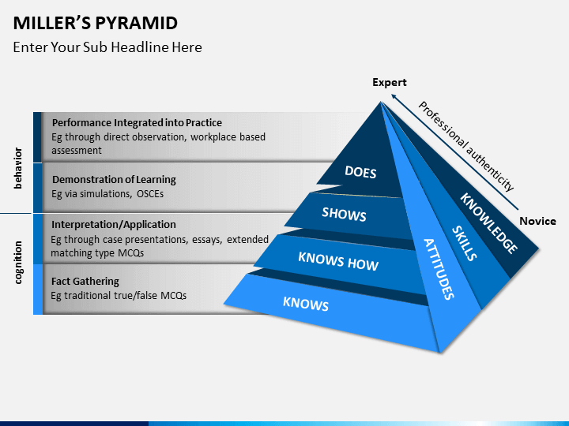


Evidence Definitions
Family Success Center

Slide 15

Rapid Fire Game: Get Ready
Think Back
Retention
Recall
Information
Questions

Slide 16

Small & Large Group Reflection:
Pausing
To Hear Your
Reflections & Experiences
On Using
Coaching Skills

Slide 17

Intro to Engagement & Active Listening
Engagement:
How Does It Show Up in Practice?
Active Listening
How Does It Show Up in Practice?

Slide 18

Break: Rejuvenate & Enjoy ☺
10 Minutes

Slide 19

What does Engagement look like at a fsc?
FSCs engage with families, individual family members, community partners, and stakeholders to build relationships in the center and community that are substantive and meaningful. Strong relationships within the community can facilitate community cohesion and social capital (McDonnel, Behn-Arieh, & Melon, 2015).

Slide 20


How do we know this is what guest can expect at any fsc?
Practice Profile
Essential Functions
Behavioral Indicators

Slide 21

What does the engagement process look like?
Building Lasting Community Connections
Pre-Arrival
On-Arrival
Communication
Marketing

Slide 22
Engagement Process
Pre-arrival
On-arrival
Home like environment
A welcoming process
Consistent and frequent
Feedback from prior events
Networking with new and existing contacts
New and creative marketing materials
Hospitable and courteous
Warm, friendly, genuine, and pleasant
Targeted programming with diverse appeal
Increased program participation
maximum outreach
Empowering Environment
Creates self sufficiency
Empowering Communication
Communication that creates self sufficiency
Pre-arrival
On-arrival
Data Bank
Marketing
Communication
Marketing
Communication

Slide 23
Engagement Process
Pre-arrival
On-arrival
Pre-arrival
On-arrival
Data Bank
Marketing
Communication
Marketing
Communication

Slide 24

Activity: Building the “Ultimate” Family Success Center Through Engagement

Slide 25

Debrief Morning……………..Frame Afternoon
Communication
Essential Function
Engagement
Community

Slide 26

Out to lunch
Time to Relax
12:15-12:45…………ENJOY

Slide 27

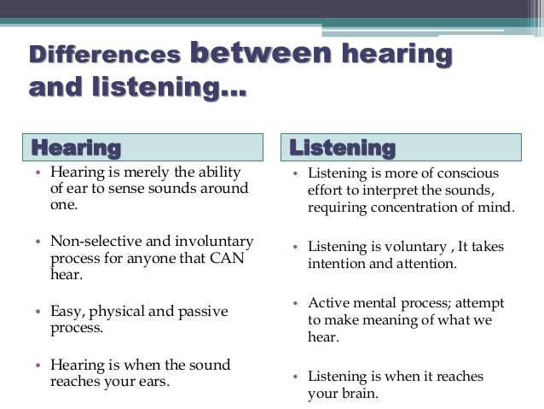
Hearing “vs” Listening

Slide 28
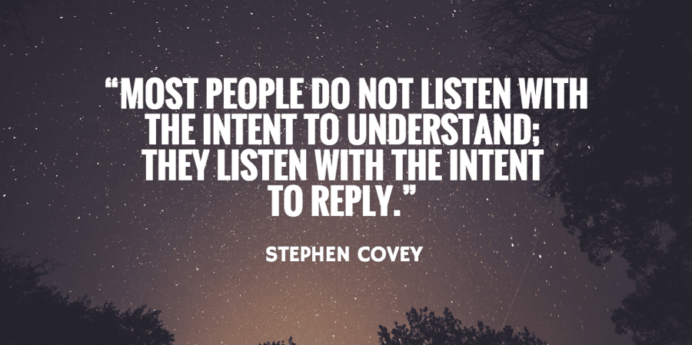

Why is Active Listening so important?

Slide 29

Active Listening
Talker
Paraphrasing
Open Ended Questions
Clarifying
Reflecting
Summarizing

Slide 30







What's Your body saying? Attending Skills

Slide 31
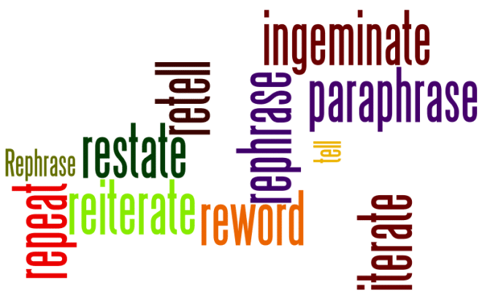


Paraphrasing
“So, what your saying is”…..
“What I heard you say is”…..
“What I heard is”……

Slide 32

Open-ended questions
“What changes would you like to make over the next 6 months”?
“What do you think mighty be the outcome of those changes”?
“What type of supports will you need”?

Slide 33


clarify
I am not sure I quite understand……?
Do you mean
that……?
Do you mean that……
Notes:
Session: Ends 1:45
Lisa
Explain to the group that when we ask for clarification, we are asking a person to explain an element of the discussion that was vague. These questions give the speaker/sender a chance to elaborate and allow the Receiver the opportunity to check the accuracy of the Senders statements.
Examples of clarifying questions include: I am not sure I quite understand; or do you mean that…?
Lets Practice…….
____________________________________________________________________________________________________
Script:
When we ask for clarification, we are asking the Speaker to explain an element of the discussion that was vague.
These questions give the speaker a chance to elaborate and allow the Listener the opportunity to check the accuracy of the Senders statements.
Examples of clarifying questions may include the following:
“I am not sure I quite understand”….
“Do you mean that”…?
Lets Practice…….

Slide 34

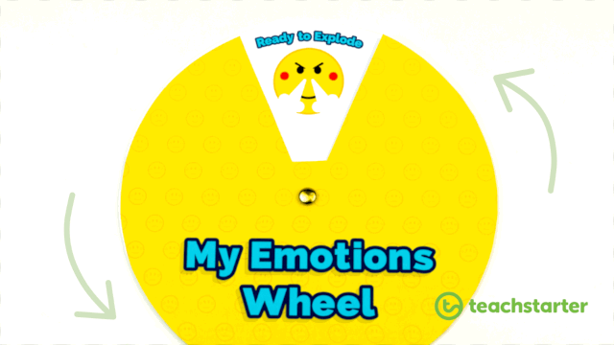
Reflecting
I wish I could Explain My Feelings to Others

Slide 35


summarize

Slide 36
Break: Rejuvenate & Enjoy ☺
10 Minutes

Slide 37


Round Robin Activity: Putting It All Together
Active Listening
&
Engagement

Slide 38



Self-Directed Work
Coaching
Practice Makes
Permanent
Facilitator
Engagement
Active Listening

Slide 39

Review of Today’s Session
Great Session
Review for deeper understanding , key coaching definitions and their link to the Family Success Center culture& Practice Profile
Experience, through practice, key coaching skills
    Seek the Issue
    Clarify Thinking
    Contribute
    Push for Action
Understand Engagement & Active Listening
Connect the coaching skills to Engagement & Active Listening
Make a Plan for application: Use coaching skills/self-directed learning to teach FSC staff Engagement & Active Listening
Directors/Leaders will have an opportunity to learn and apply the fundamental aspects of Engagement & Active Listening as defined by the Practice Profile

Slide 40

Post Learning Evaluation: Good Luck

Slide 41


Thank you
Sean Murphy: Assistant Director of Practice
Lisa Gallagher: Executive Director

